Slide 1


Slide 2

مدیریت استراتژیک فناوری اطلاعات آگاهی و اتخاذ تصمیم
تهیه و تنظیم:
رضا میرزاباقری

Slide 3
Related Quotes
“Be sure you are right -- then go ahead.”
Davy Crocket.
“Doing what's right isn't hard -- Knowing what's right is.”
Lyndon B. Johnson.
“Mine own applause is the only applause which matters.”
Cicero.

Slide 4
Definitions
Problem
Exists whenever objectives are not being met.
What is happening vs. what is wanted to happen
Problem Solving
The process of taking corrective action to meet objectives.

Slide 5
Definitions
Decision
a choice made from available alternatives
Decision Making
The process of selecting an alternative course of action that will solve a problem.
First decision is whether to take corrective action.

Slide 6
Relationship among the Management Functions
The Relationship among the Management Functions, Decision Making, and Problem Solving
Managers need to make proficient decisions while performing the functions of management.

Slide 7
Managerial
Decision Making
Decision Making Approach
Rationality
Bounded rationality
Intuition
Decision Making Errors & Biases
Decision Making Process
Decision Maker’s Style
Directive
Analytic
Conceptual
Behavioural
Decision Making Condition
Certainty
Risk
Uncertainty
Types of Problems & Decisions
Well structured - Programmed
Unstructured – Nonprogrammed

Slide 8
Managerial
Decision Making
Decision Making Approach
Rationality
Bounded rationality
Intuition
Decision Making Errors & Biases
Decision Making Process
Decision Maker’s Style
Directive
Analytic
Conceptual
Behavioural
Decision Making Condition
Certainty
Risk
Uncertainty
Types of Problems & Decisions
Well structured - Programmed
Unstructured – Nonprogrammed

Slide 9
The Decision-Making Process
1
2
3
4
5
6
7
Identifying the Problem
Set Objectives and Identifying Decision Criteria
Developing Alternatives
Analyzing Alternatives
Selecting an Alternative
Implementing the Alternative
Evaluating and Control the Decision
A 7 step process that when properly utilized increases chances of success in decision making and problem solving.

Slide 10
The Decision-Making Process
Step 1: Identifying the Problem
Problem
A difference between an existing and desires
Tips:
A problem becomes a problem when a manager becomes aware of it.
There is pressure to solve the problem.
The manager must have the authority, information or resources needed to solve the problem.

Slide 11
The Decision-Making Process
Step 2: Set Objectives and Identifying Decision Criteria
Decision criteria are factors that are important (relevant) to resolving the problem.
Costs (investments required)
Risks (chance of failure)
Outcomes (growth of the firm)

Slide 12
The Decision-Making Process
Step 3: Developing Alternatives
Identifying viable alternatives
Alternatives are listed (without evaluation) that can resolve the problem.
Step 4: Analyzing Alternatives
Evaluating each alternative’s strengths and weaknesses
An alternative’s evaluation is based on its ability to resolve the issues identified in step 2.

Slide 13
The Decision-Making Process
Step 5: Selecting an Alternative
Choosing the best alternative
The alternative with the highest total weight is chosen.
Step 6: Implementing the Alternative
Putting the chosen alternative into action.
Conveying the decision to and gaining commitment from those who will carry out the decision.

Slide 14
The Decision-Making Process
Step 7: Evaluating and Control the Decision
The reliability of the decision is judged by its outcomes.
How effectively was the problem resolved by outcomes resulting from the chosen alternatives?
If the problem was not resolved, what went wrong?

Slide 15
Managerial
Decision Making
Decision Making Approach
Rationality
Bounded rationality
Intuition
Decision Making Errors & Biases
Decision Making Process
Decision Maker’s Style
Directive
Analytic
Conceptual
Behavioural
Decision Making Condition
Certainty
Risk
Uncertainty
Types of Problems & Decisions
Well structured - Programmed
Unstructured – Nonprogrammed

Slide 16
Decision Making Approach
Rationality
The decision maker attempts to use optimizing and selecting the best possible alternative.
Assumptions are that decision makers:
Are perfectly rational, fully objective, and logical.
Have carefully defined the problem and identified all viable alternatives.
Have a clear and specific goal
Will select the alternative that maximizes outcomes in the organization’s interests rather than in their personal interests.

Slide 17
Decision Making Approach…
Bounded Rationality
Managers make decisions rationally, but are limited (bounded) by their ability to process information.
Assumptions are that decision makers:
Will not seek out or have knowledge of all alternatives
Will satisfice — choose the first alternative encountered that satisfactorily solves the problem—rather than maximize the outcome of their decision by considering all alternatives and choosing the best.

Slide 18
Decision Making Approach…
The Role of Intuition
Intuitive decision making
Making decisions on the basis of experience, feelings, and judgment.

Slide 19
Managerial
Decision Making
Decision Making Approach
Rationality
Bounded rationality
Intuition
Decision Making Errors & Biases
Decision Making Process
Decision Maker’s Style
Directive
Analytic
Conceptual
Behavioural
Decision Making Condition
Certainty
Risk
Uncertainty
Types of Problems & Decisions
Well structured - Programmed
Unstructured – Nonprogrammed

Slide 20
Types of Problems and Decisions
Structured Problems
Involve goals that clear.
Are familiar (have occurred before).
Are easily and completely defined
information about the problem is available and complete.
Programmed Decision
A repetitive decision that can be handled by a routine approach.

Slide 21
Types of Problems and Decisions…
Unstructured Problems
Problems that are new or unusual and for which information is ambiguous or incomplete.
Problems that will require custom-made solutions.
Nonprogrammed Decisions
Decisions that are unique and not repeated.
Decisions that generate unique responses.

Slide 22
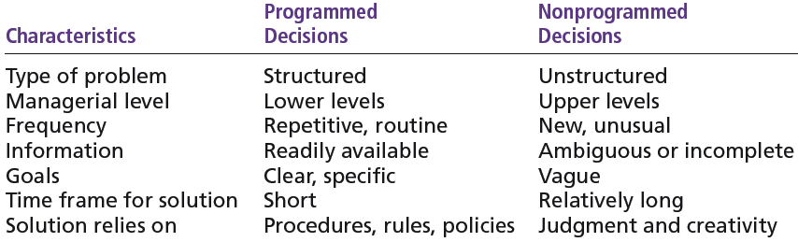
Programmed versus Nonprogrammed Decisions

Slide 23
Managerial
Decision Making
Decision Making Approach
Rationality
Bounded rationality
Intuition
Decision Making Errors & Biases
Decision Making Process
Decision Maker’s Style
Directive
Analytic
Conceptual
Behavioural
Decision Making Condition
Certainty
Risk
Uncertainty
Types of Problems & Decisions
Well structured - Programmed
Unstructured – Nonprogrammed

Slide 24
Decision-Making Conditions
Certainty
A situation in which a manager can make an accurate decision because the outcome of every alternative choice is known.
Risk
A situation in which the manager is able to estimate the likelihood (probability) of outcomes that result from the choice of particular alternatives.

Slide 25
Decision-Making Conditions
Uncertainty
Limited information prevents estimation of outcome probabilities for alternatives associated with the problem and may force managers to rely on intuition and “gut feelings”.

Slide 26
Managerial
Decision Making
Decision Making Approach
Rationality
Bounded rationality
Intuition
Decision Making Errors & Biases
Decision Making Process
Decision Maker’s Style
Directive
Analytic
Conceptual
Behavioural
Decision Making Condition
Certainty
Risk
Uncertainty
Types of Problems & Decisions
Well structured - Programmed
Unstructured – Nonprogrammed

Slide 27
Decision-Makers Styles
Types of Decision Makers
Directive
Use minimal information and consider few alternatives.
Analytic
Make careful decisions in unique situations.
Conceptual
Maintain a broad outlook and consider many alternatives in making decisions.
Behavioral
Avoid conflict by working well with others and being receptive to suggestions.

Slide 28
Decision-Making Styles
Dimensions of Decision-Making Styles
Ways of thinking
Rational
Intuitive
Tolerance for ambiguity
Low tolerance: require consistency and order
High tolerance: multiple thoughts simultaneously

Slide 29
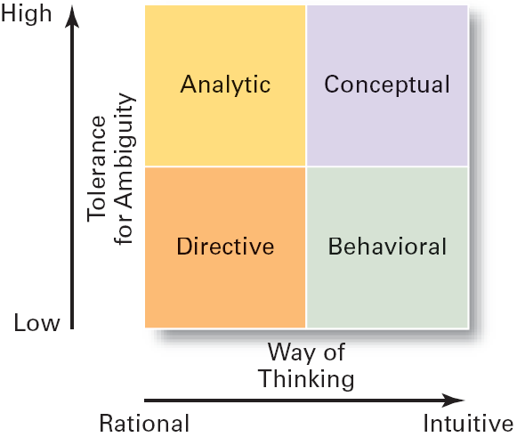
Decision-Making Matrix

Slide 30
Managerial
Decision Making
Decision Making Approach
Rationality
Bounded rationality
Intuition
Decision Making Process
Decision Maker’s Style
Directive
Analytic
Conceptual
Behavioural
Decision Making Condition
Certainty
Risk
Uncertainty
Types of Problems & Decisions
Well structured - Programmed
Unstructured – Nonprogrammed
Decision Making Errors & Biases

Slide 31
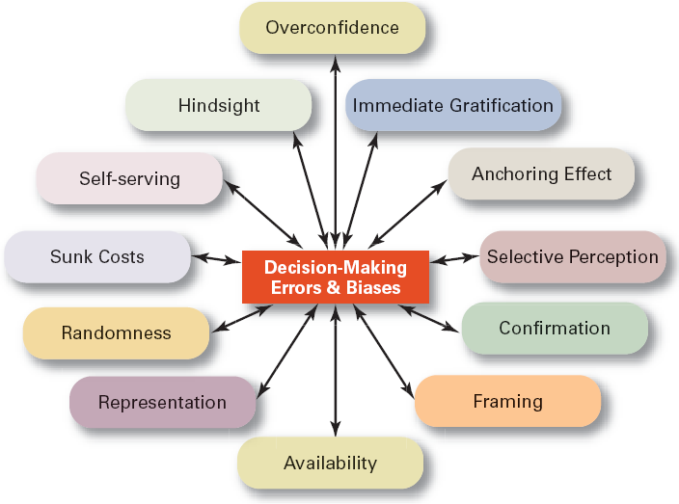
Common Decision-Making Errors and Biases

Slide 32
Managerial
Decision Making
Decision Making Approach
Rationality
Bounded rationality
Intuition
Decision Making Errors & Biases
Decision Making Process
Decision Maker’s Style
Directive
Analytic
Conceptual
Behavioural
Decision Making Condition
Certainty
Risk
Uncertainty
Types of Problems & Decisions
Well structured - Programmed
Unstructured – Nonprogrammed

Slide 33
Characteristics of an Effective Decision-Making Process
It focuses on what is important.
It is logical and consistent.
It acknowledges both subjective and objective thinking and blends analytical with intuitive thinking.
It requires only as much information and analysis as is necessary to resolve a particular dilemma (problem).
It guides the gathering of relevant information.
It is straightforward, reliable, easy to use, and flexible.

Slide 34
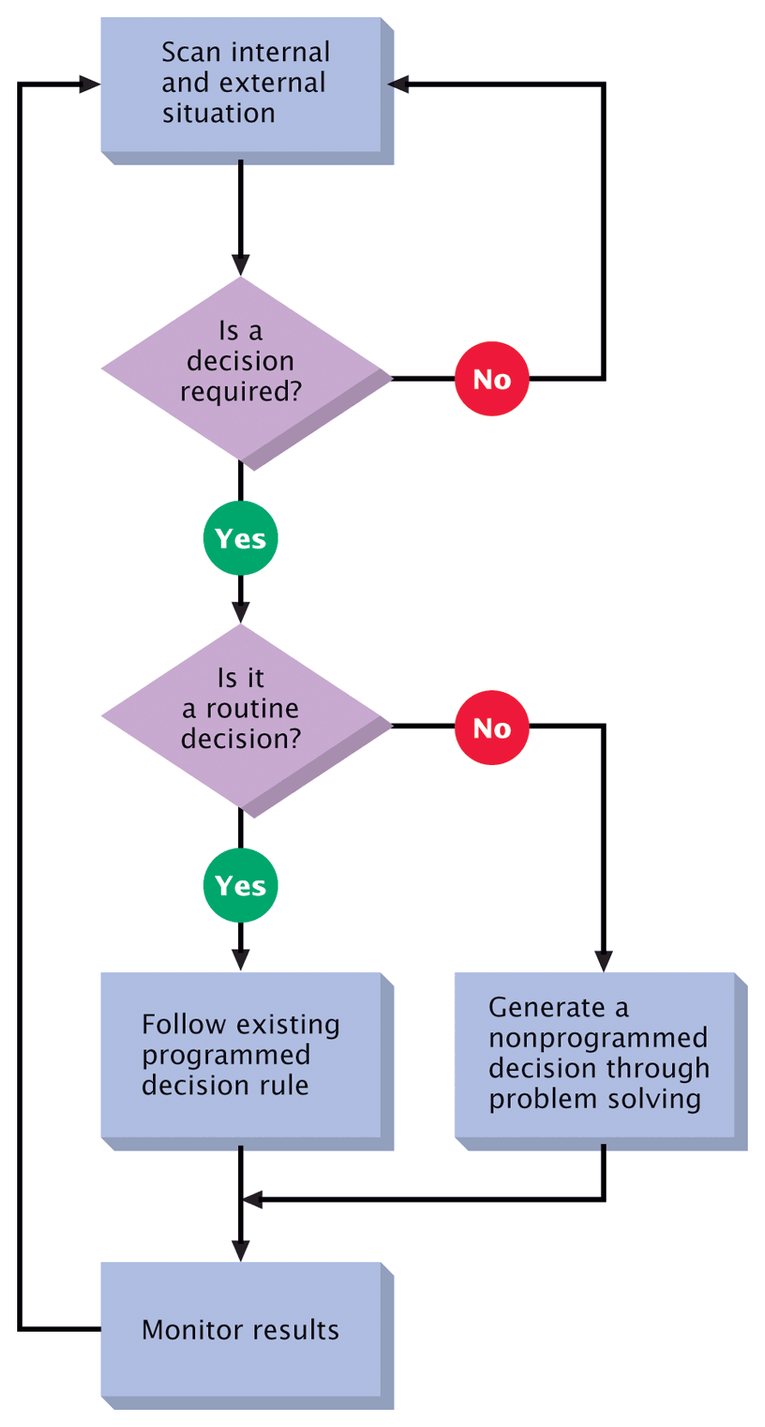
A General Decision Making Model

Slide 35
Group Decision Making Advantages vs. Disadvantages
Potential Advantages
Potential Disadvantages
Better-quality decisions
More information, alternatives, creativity, and innovation
Better understanding of the decision
Greater commitment to the decision
Improved morale and motivation
Good training
Wasted time and slower
Satisficing
power and goal displacement
agreement and groupthink

Slide 36
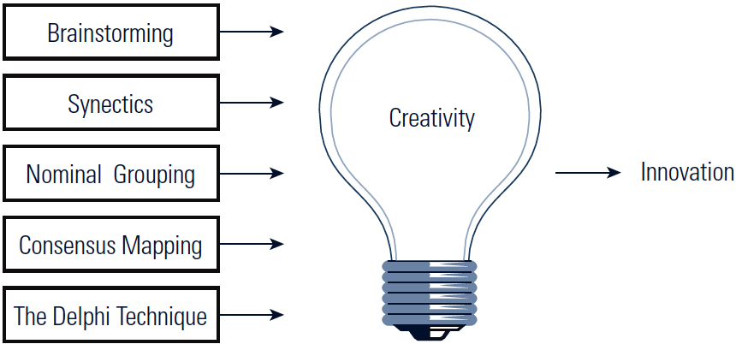
Group Decision-Making Techniques That Foster Creativity

Slide 37
Responses That Kill Creativity
“It can’t be done.”
“We’ve never done it.”
“Has anyone else tried it?”
“It won’t work in our department (company/industry).”
“It costs too much.”
“It isn’t in the budget.”
“Let’s form a committee.”

Slide 38
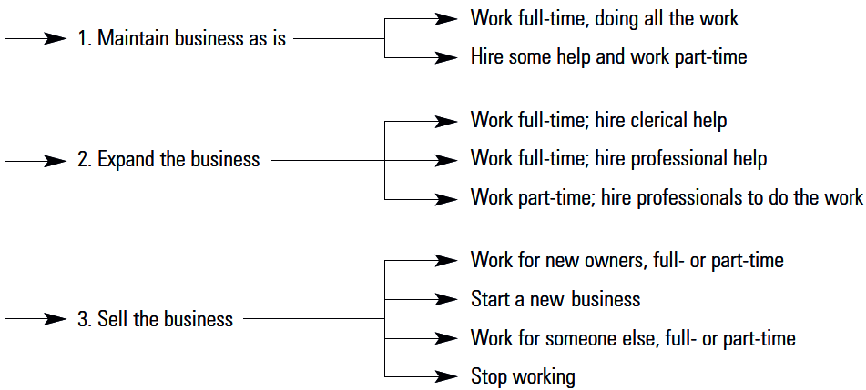
Decision Tree

Slide 39


